Slide 1
Mott’s Fruit Snacks
Exploratory Analysis for textual data

Slide 2
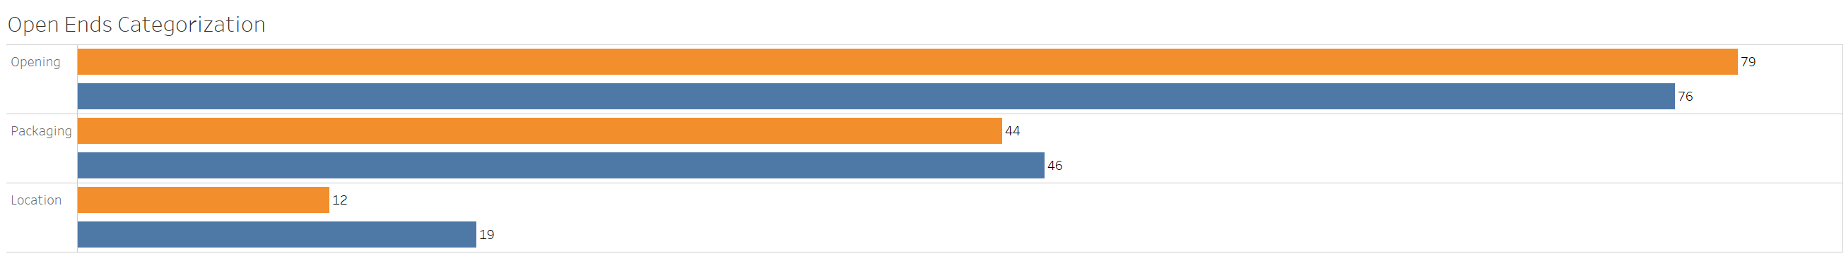
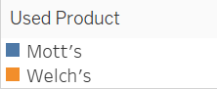
Packaging – Topic Categorization
Use sheet : topic_categorization

Slide 3
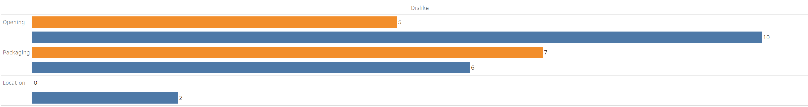
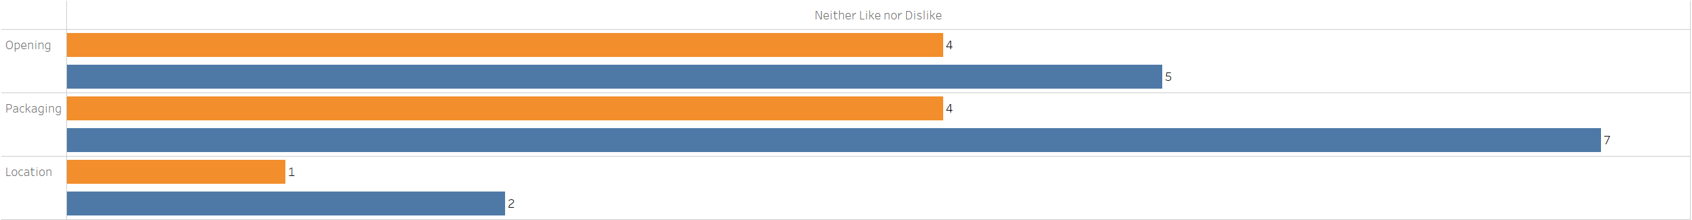
Overall Liking with Topic Categorization

Slide 4
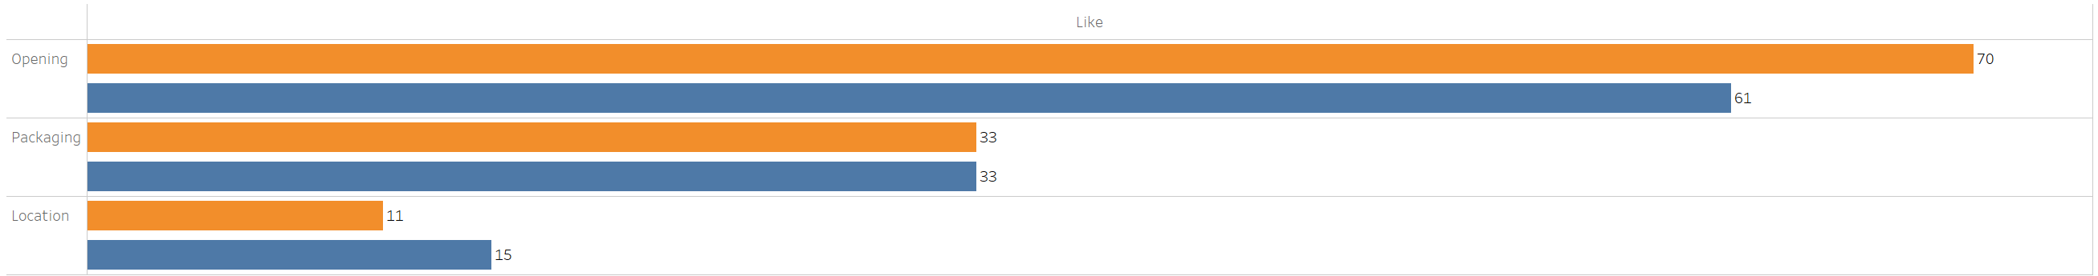
Overall Liking with Topic Categorization

Slide 5
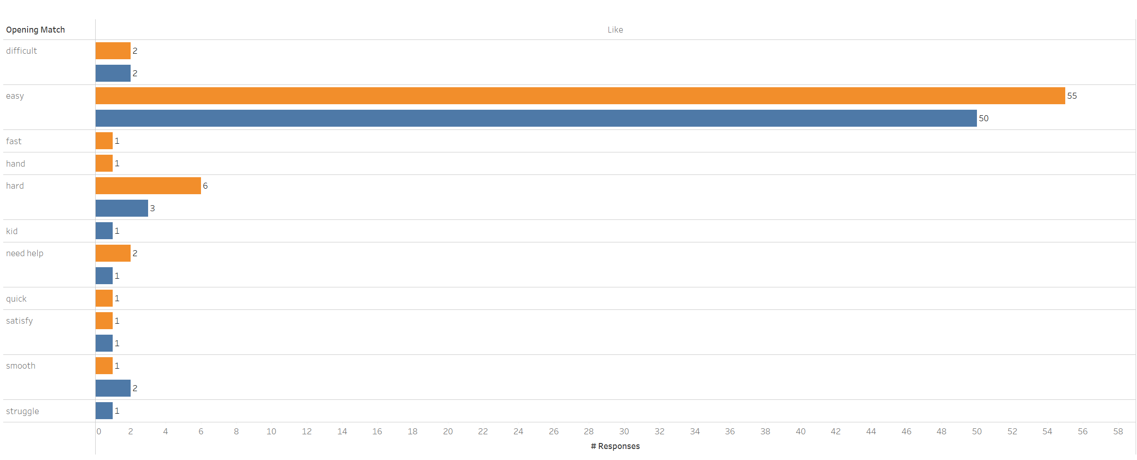
Topic Breakdown - Opening
Notes:
Maybe look at top 3 most used words within the category?

Slide 6
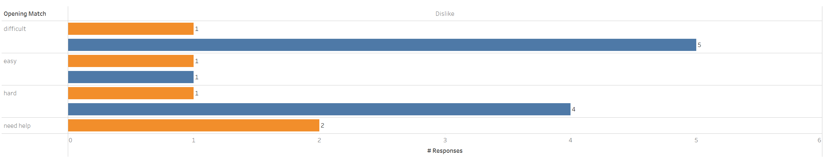
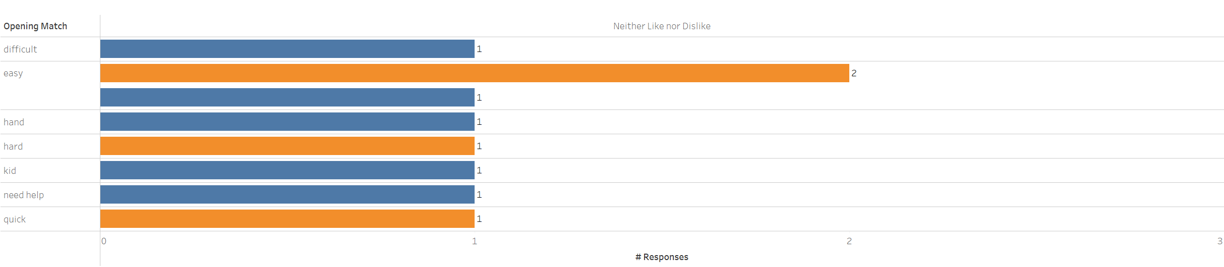
Topic Breakdown – Opening

Slide 7
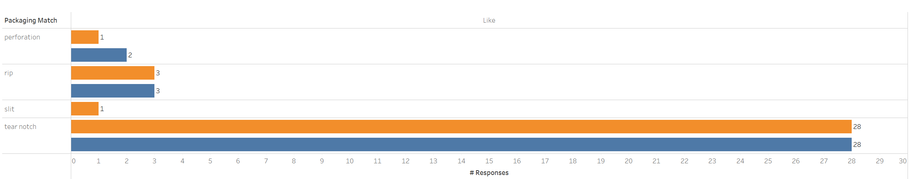
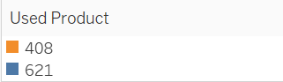
Topic Breakdown – Packaging

Slide 8
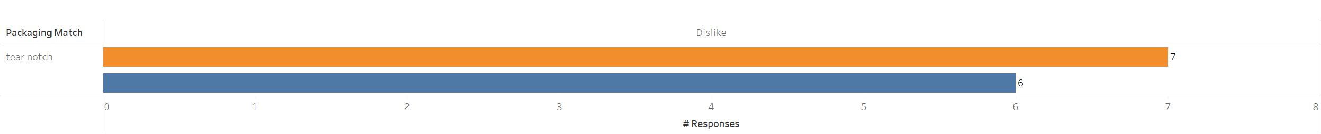
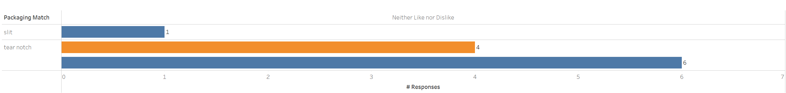
Topic Breakdown – Packaging

Slide 9
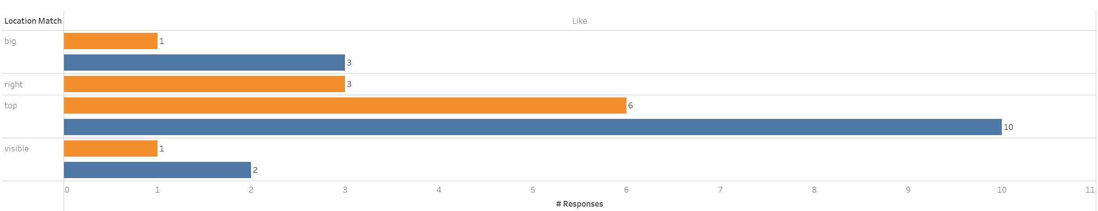
Topic Breakdown – Location

Slide 10
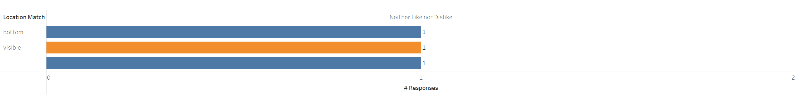
Topic Breakdown – Location

Slide 11
Most Frequently words that appear together
Mott’s Fruit Snacks
Pretzels Inc Micro Mini and Pretzels Inc Stick
Words | Frequency
Easy – open | 31
Tear – notch | 11
Tear – open | 10
Fruit – snack | 10
Easy – tear | 7
Words | Frequency
rye - chip | 47
snack – mix | 14
Love – rye | 8
Open – tear | 6
Hard – find | 4
Notes:
'rye', 'chip'), 47), (('snack', 'mix'), 14), (('love', 'rye'), 8), (('chip', 'favorite'), 8), (('variety', 'item'), 7

Slide 12
Collocations
The tear notch was for Welch’s fruit snacks was harder to find (4 responses)
Both as easier to open but welch’s is relatively easier than mott’s (41 vs 31)

